Slide 1
Project A
Final Project Review
Jesse Mendoza
Jake Miller
Braden Stotmeister

Slide 2
Part 1

Slide 3
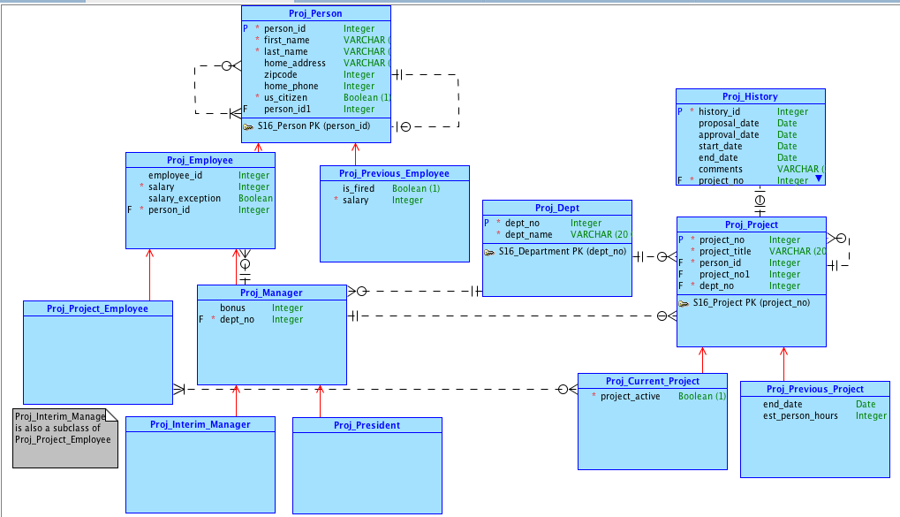
Conceptual Model

Slide 4
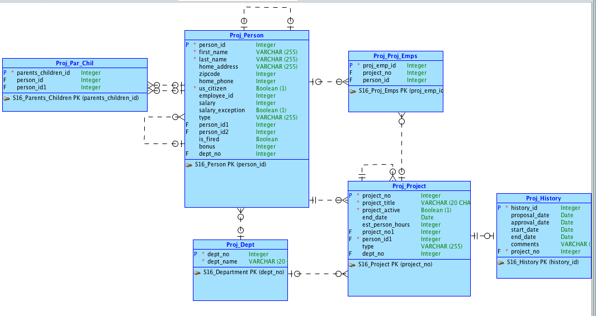
Logical Model

Slide 5
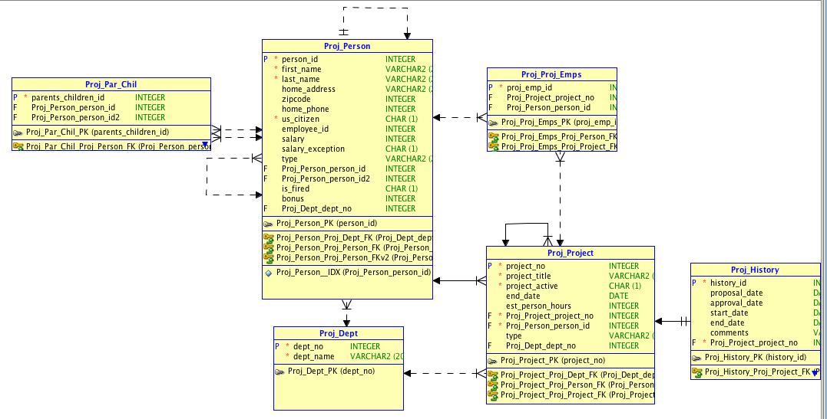
Relational Model

Slide 6
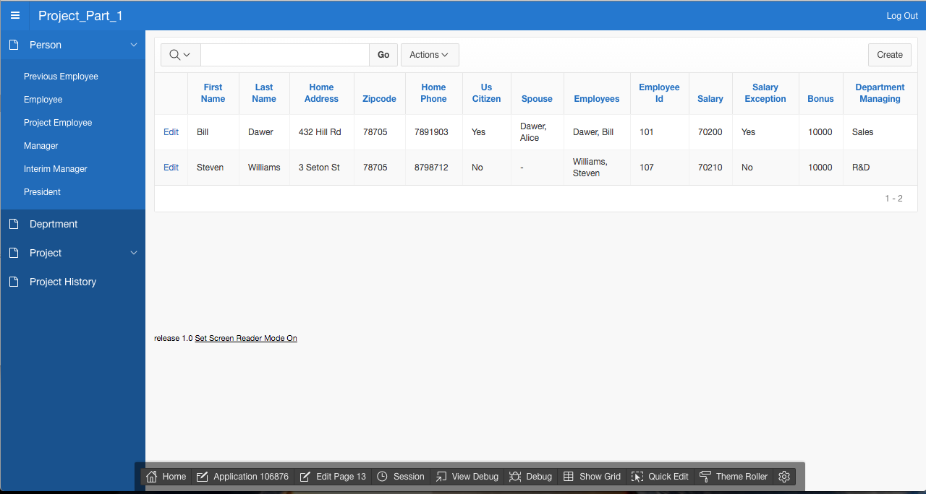

Slide 7
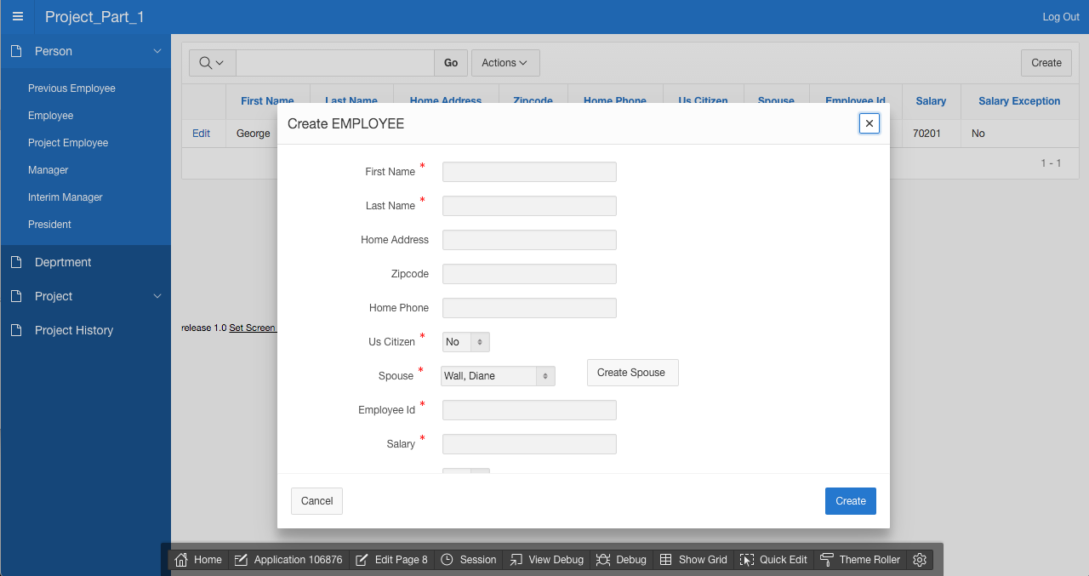

Slide 8
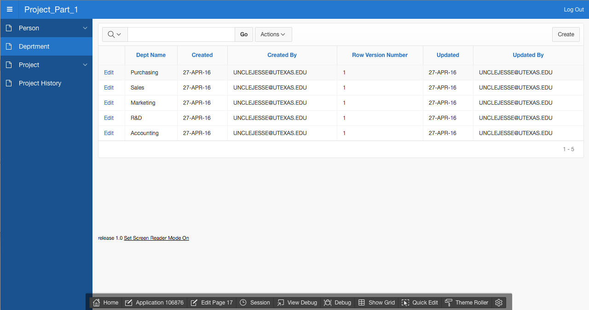

Slide 9
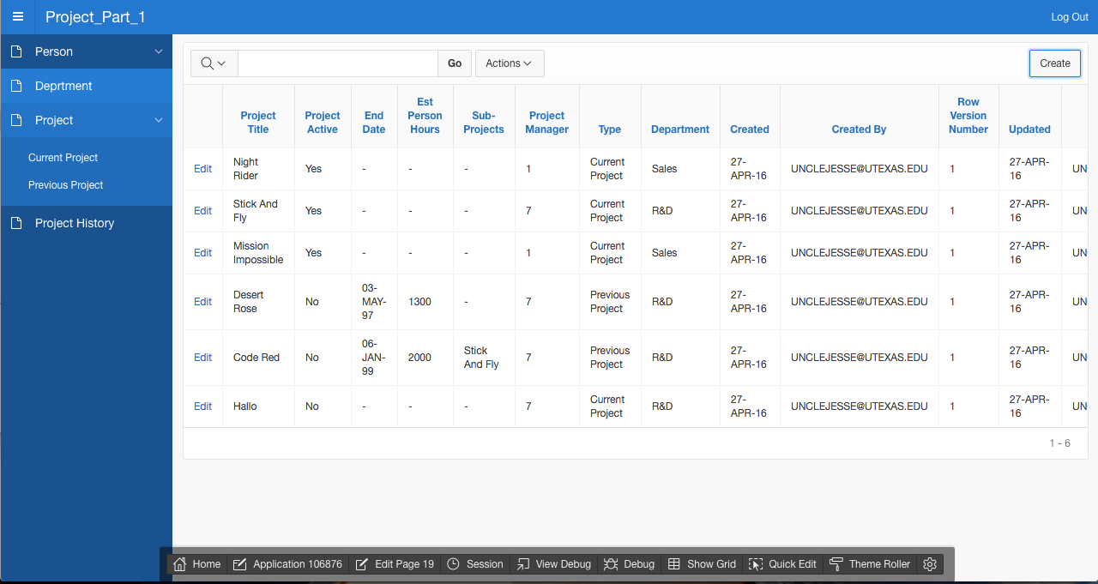

Slide 10
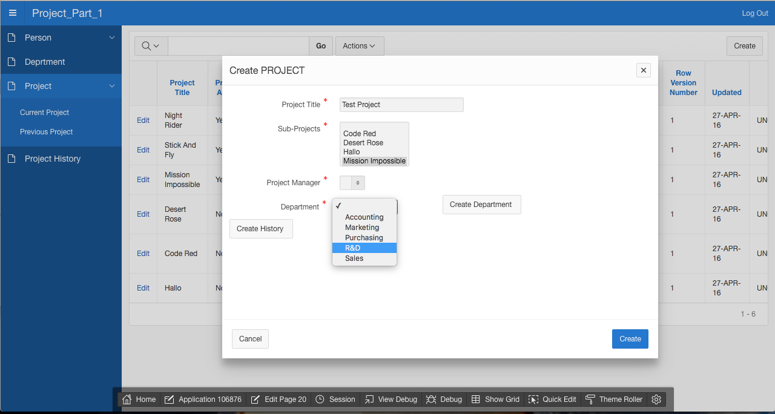

Slide 11
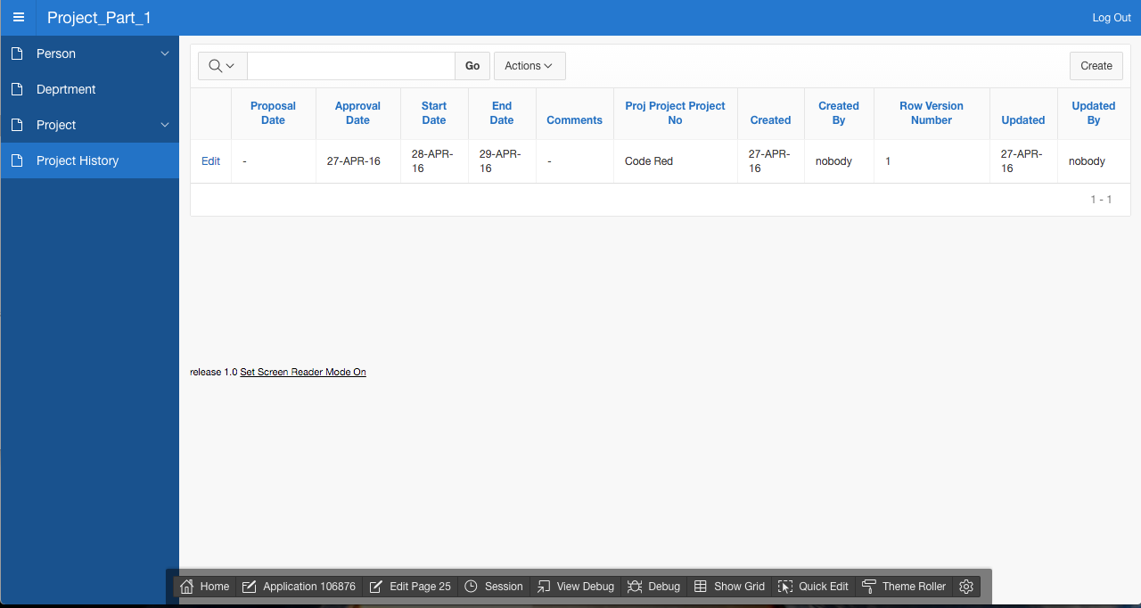

Slide 12
Part 2

Slide 13
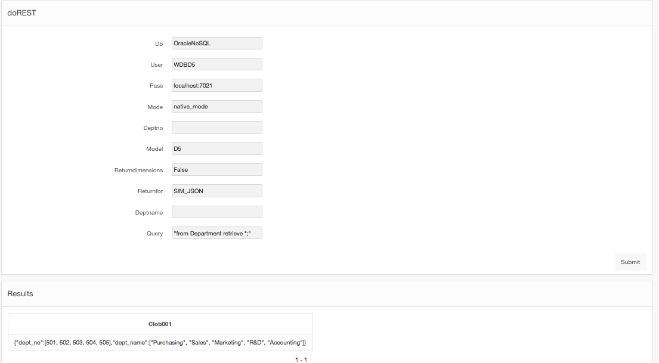

Slide 14
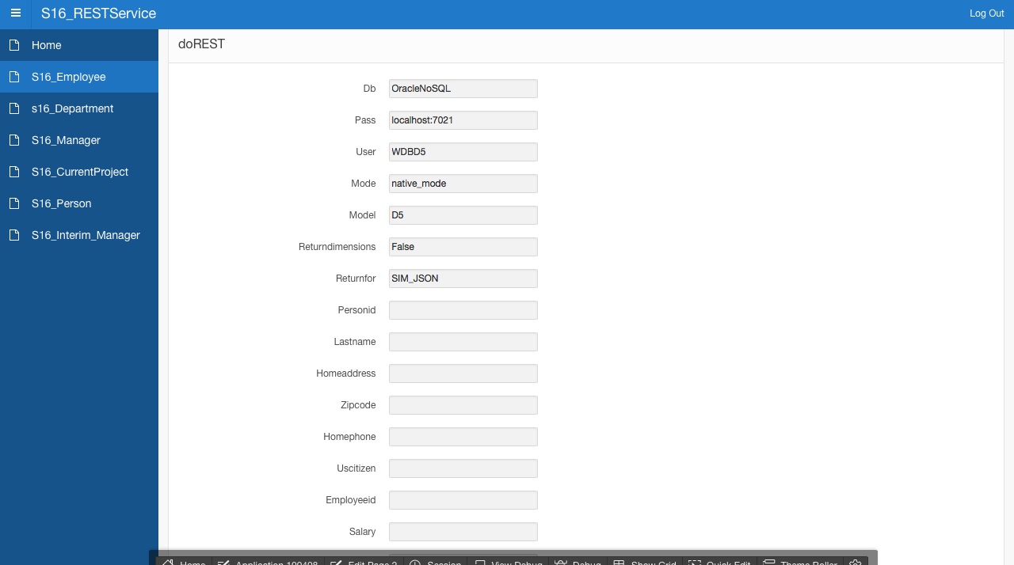

Slide 15
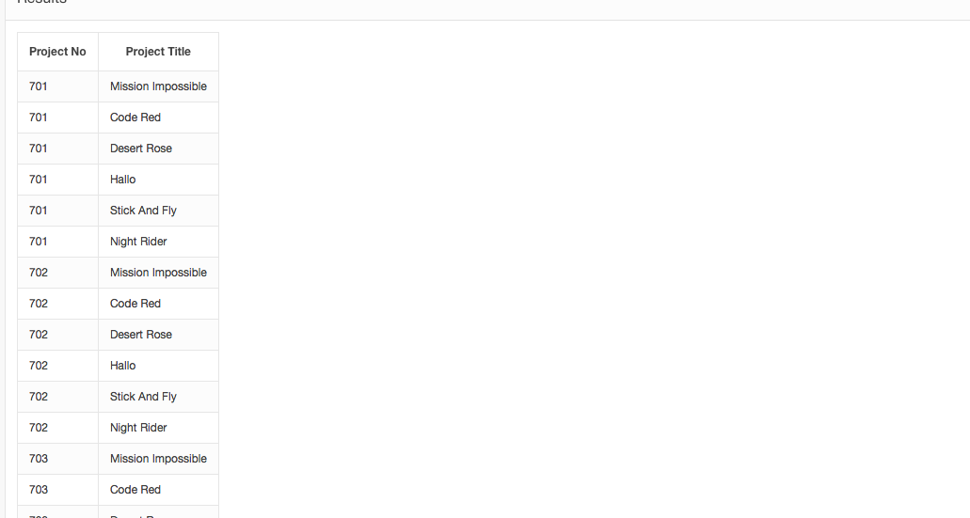

Slide 16
Differences Between SIM and Relational
understands object oriented-ness
No need to make DDL’s

Slide 17
Github, Apex
https://github.com/UncleJesse/S16D5_DMProject.git
https://apex.oracle.com/pls/apex/f?p=106876:5:15989110061627::NO:::

Slide 18
Thank you
Project A
Jesse Mendoza
Jake Miller
Braden Stotmeister

